Slide 1
Variable Inductance Transducers
The variable inductance transducers work, generally, upon one of the following three principles:
Change of self-inductance
Change of mutual inductance, and
Production of eddy currents

Slide 2
Transducers working on principle of change of self-inductance :
Self-inductance of a coil, L=N²/R
Where N= number of turns, and
R= reluctance of magnetic circuit.
where R=L/µA
Therefore Inductance L=N²µ (A/L) =N²µG …. (i)
Where µ= effective permeability in and around of coil; H/m
G=A/L= geometric form factor
A= area of cross section of coil; m²
and L= length of coil; m

Slide 3
It is clear from Equation (i) that the variation in inductance may be caused by:
Change in number of turns, N,
Change in geometric configurations, G, and
Change in permeability, µ.
Inductive transducers are mainly used for displacement measurement.

Slide 4
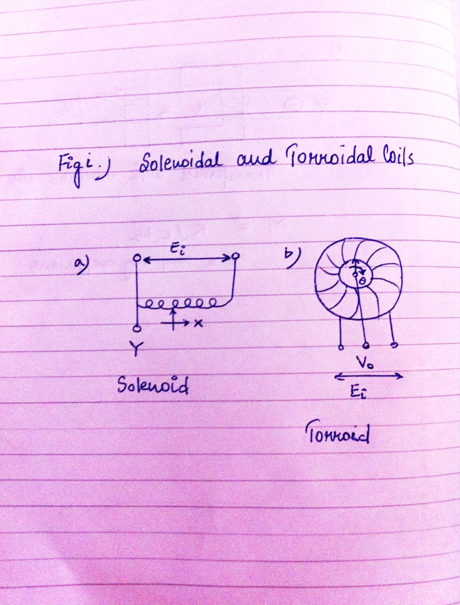

Slide 5
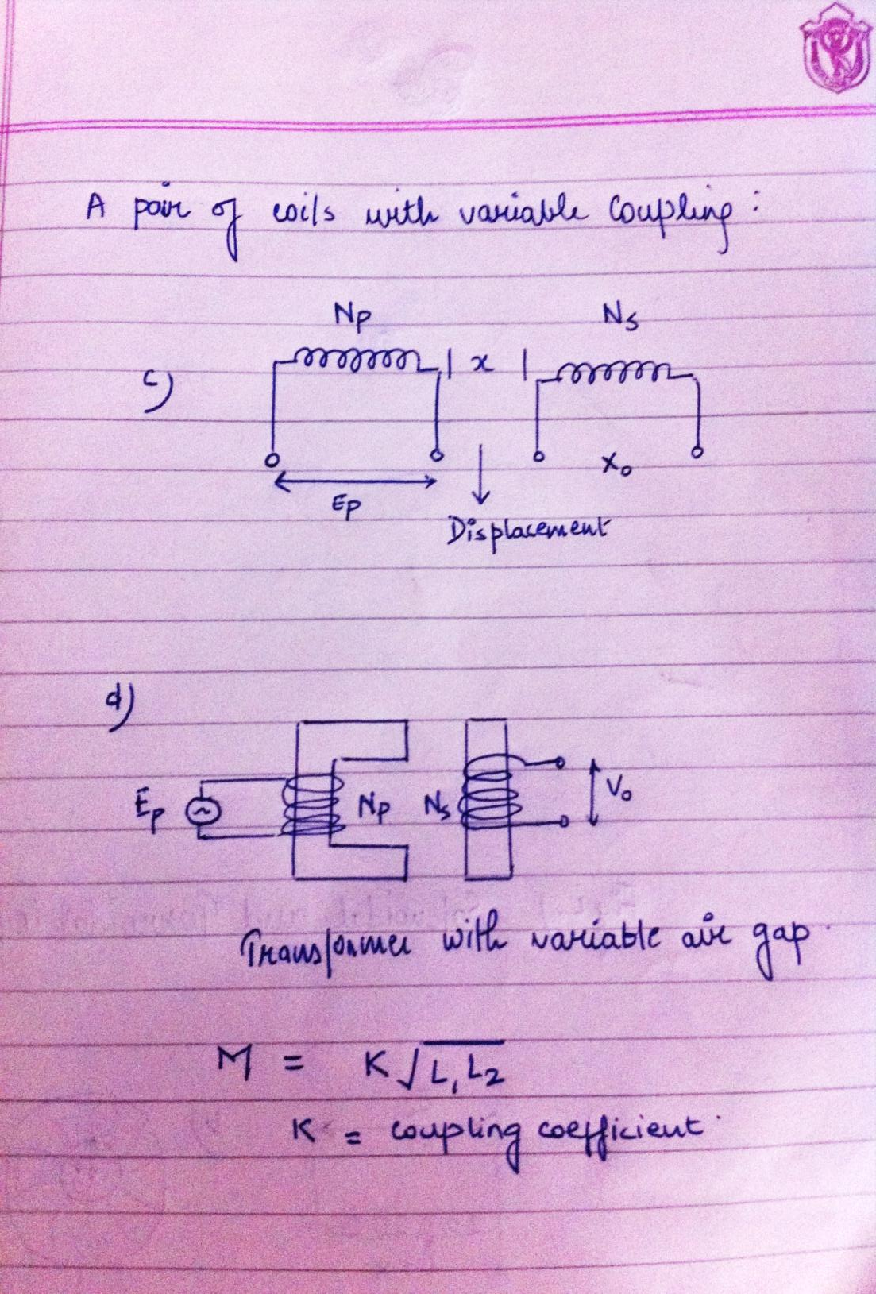

Slide 6
2. Transducers working on principle of change of mutual inductance :
The mutual inductance between two coils is,
M = K√L₁L₂
Where L₁ and L₂ = self-inductances of two coils,
and K= co-efficient of coupling.
The mutual inductance between coils can be varied by variation of self-inductance by connecting the coils in series. The Self-inductance of such an arrangement varies between L₁+L₂-2M to L₁+L₂+2M with one of coils being stationary while other is movable.
Self-inductance of each coil is constant but the Mutual inductance change depends upon displacement of moving coil.

Slide 7
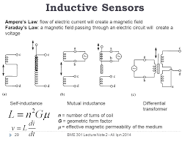

Slide 8
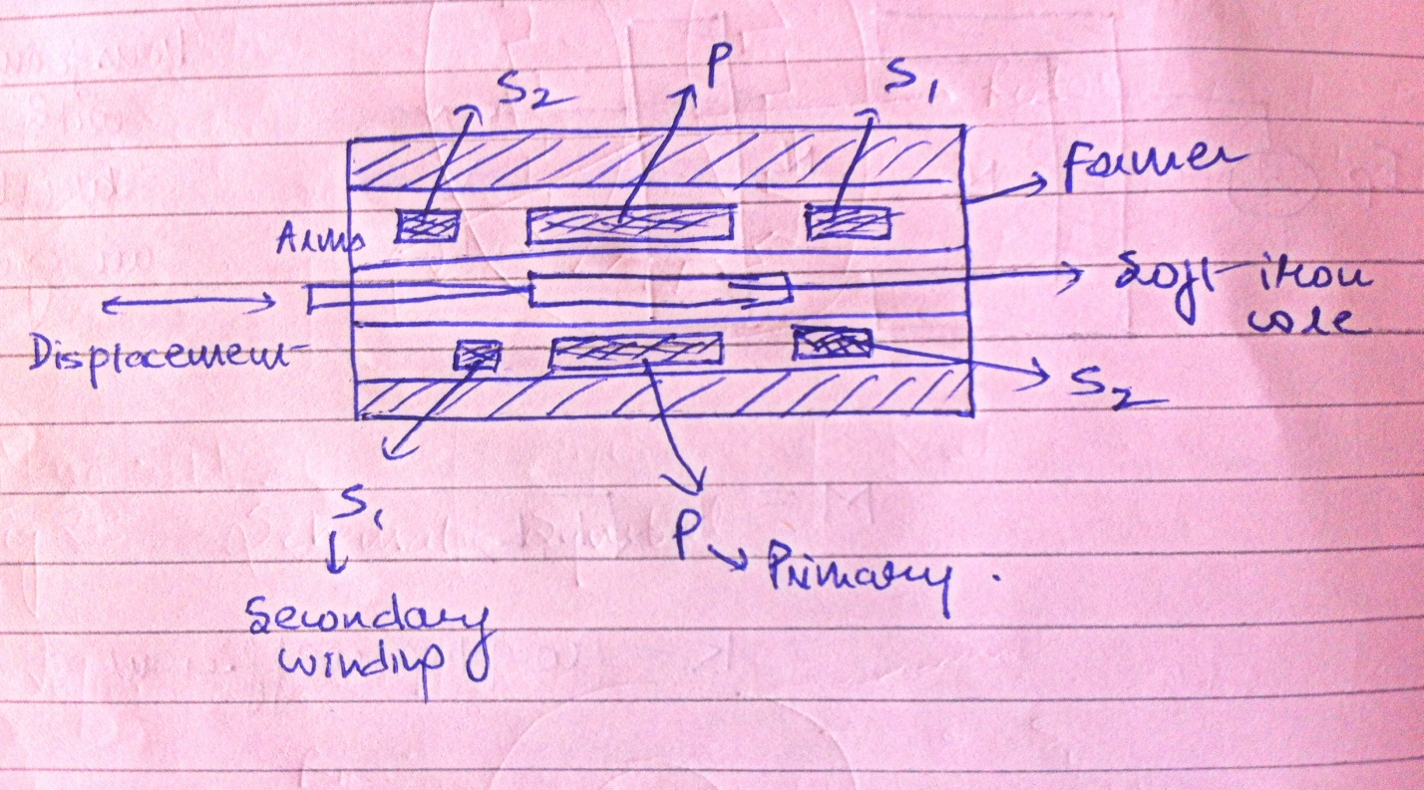
LINEAR VARIABLE DIFFRENTIAL TRANSFORMER (LVDT)

Slide 9
Most widely used inductive transducer to translate the linear motion into electrical signals is linear variable differential transformer.
It consists of a single primary winding P and two secondary windings S₁ and S₂ wound on a cylindrical former.
Secondary windings have an equal number of turns and placed either side of the primary.
The primary winding connected to alternating current source.
Movable soft iron core placed inside former.
The displacement to be measured is applied to the arm to soft iron core.
The frequency of a.c. applied to primary windings may be between 50 Hz to 20 kHz.
Output voltage of S₁= ES₁
Output voltage of S₂= ES₂

Slide 10
Advantages, disadvantages and applications of linear variable differential transformer (LVDT)
Advantages:
There are some advantages of linear variable differential transformer (LVDT) which are given below,
The LVDT has low power consumption.
It has higher sensitive.
It has ruggedness.
It has wide range.
It has low hysteresis.

Slide 11
Disadvantages:
There are some disadvantages of linear variable differential transformer (LVDT) which are given below,
It has large primary voltage produce distortion in output.
Temperature affects the performance.
Sensitive to stray magnetic field.
The dynamic response is limited mechanically by the mass of the core.

Slide 12
Applications:
There are some important applications of linear variable differential transformer (LVDT) which are given below,
It act as a secondary transducer, it is used to measure force, weight and pressure.
The LVDT can be used for displacement measurement ranging from fraction of mm to few cm.

Slide 13
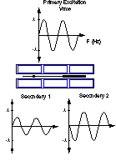
Differencing the two secondary voltages results in “zero” output volts. This is the null position of the LVDT. In reality , there is a small residual voltage left due to factors like winding capacitance and variances in the magnetic materials.

Slide 14
Residual Voltage in LVDT
Ideally, the output voltage at the null position should be equal to zero. However, in actual practice, there exists a small voltage known as Residual Voltage, at the null position. This may be by virtue of the presence of harmonics in the input supply voltage and also due to harmonics produced in the output voltage on account of the use of the iron core. There may be either some magnetic or electrical unbalance or both which result in a finite output voltage at null position. Other causes of residual voltage are stray magnetic fields and temperature effects.

